Slide 1
Multi-modal anomaly detection in oil rig operations using time series and text logs
Chevron

Slide 2
Problem Statement
Oil rigs generate large volumes of sensor data (e.g, pressure, temperature, vibration) and unstructured operator logs. Your task is to:
1. Detect anomalies in sensor data.
2. Correlate anomalies with operator logs using NLP.
3. Generate insights using GenAI (e.g., summaries, root cause hypotheses).
4. Deploy a minimal working prototype (e.g., Stream lit, Flask, or CLI).

Slide 3
Problem Statement
Equipment in the system ('Pump_1','Pump_2','Pump_3’).
Time series Data range from 5th March to 5th July 2025.
Capturing Hourly Data ( Days -122, 24 Hours)
Two Input files considered
Sensor data (Timestamp, Equipment, Temperature, Pressure & Vibration)
Text logs(Timestamp, Equipment & Operator messages)

Slide 4
Sensor Data
Generated random values from a normal distribution.
(mean, standard deviation, size).
This is to create a normal operating behaviour over time.
To mimic the real time scenario added noise .
Injected anomalies in pressure , temperature and vibration.
Introduced missing value in the sensor data.

Slide 5
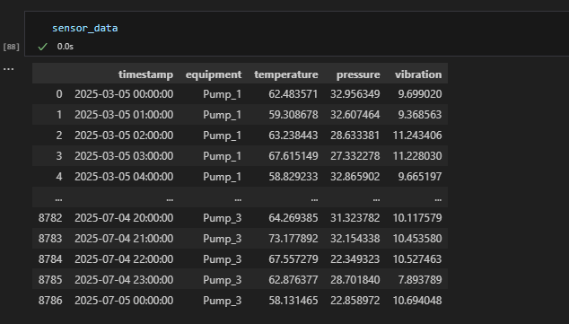
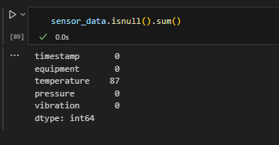
Sensor Data

Slide 6
To Detect Anomalies
To detect anomalies in the sensor data , we have used isolation forest.
Before fitting the Isolation forest , we have use the standard scaler to bring the data on a same scale.
We have used the contamination 1 % (to assume 1% of data is anomaly)
Upon fitting the model it assigns 1 for Normal and -1 for anomalies.
For clarity mapped the 1 & -1 to Normal and Anomaly.

Slide 7
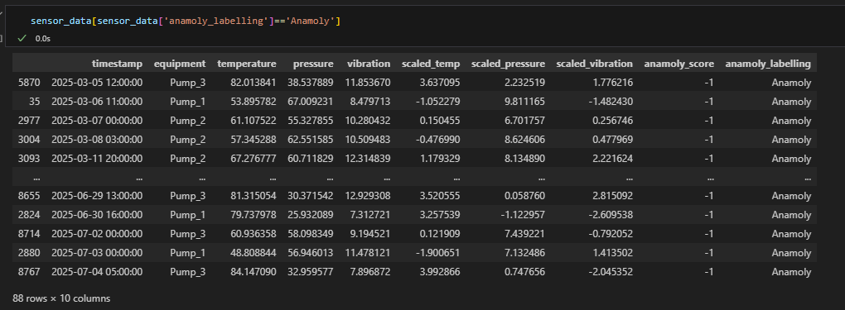
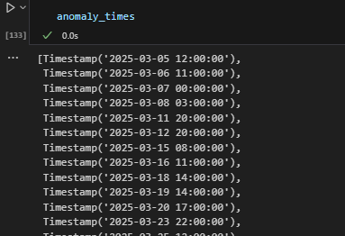
To Detect Anomalies
Abnormal sensor data.
After this extract the timestamps of anomaly rows to help generate the meaningful logs.

Slide 8
Text Logs
To create the text logs simulated the operator messages i.e. customized log message template.
We have created the text log file by taking reference from anomalies DataFrame (timestamp & equipment ) .
For each anomaly , pretending that operator has saw it.
Created 3 new messages around the same time (+-6 hours )
Used random messages from the log messages template.
Used random equipment from the anomalies Dataframe.

Slide 9
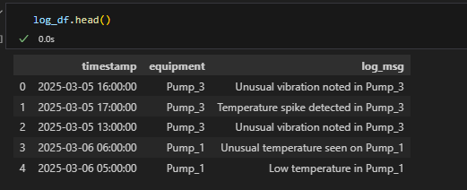
Text Logs
The text logs comprised of 3 columns timestamp, equipment and log_msg.

Slide 10
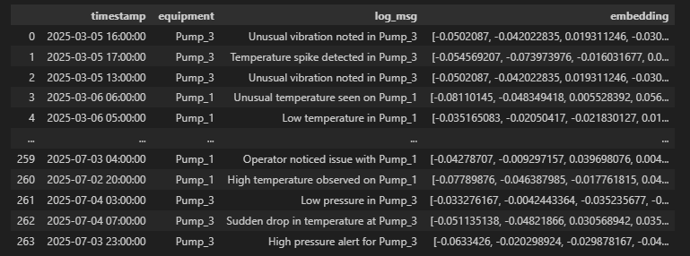
Sentence Transformer
Used a pre-trained model that understand sentence meanings
'all-MiniLM-L6-v2’
This model converts each sentence into a numerical vector (called embedding)

Slide 11
Matching Anomalies to Relevant Text Logs (Based on Meaning & Time)
Converts each anomaly's sensor values into a sentence and generates its vector using a SentenceTransformer model.
Searches for log messages with the same equipment and timestamp within ±6 hours, then compares them using cosine similarity.
Returns the most similar log message (or a fallback) with its timestamp, message, and similarity score.
row = {
'timestamp': '2025-03-07 10:00:00',
'equipment': 'Pump_2',
'temperature': 61.2, anomaly_text = "Temperature 61.2, Pressure 55.0, Vibration 10.1“ Embedding(Sentence Transformer) Check the text log for same equipment(pump_2) & within +- 6
hours of 'timestamp . it's comparing text log from same pump same time range
'pressure': 55.0,
'vibration': 10.1
}

Slide 12
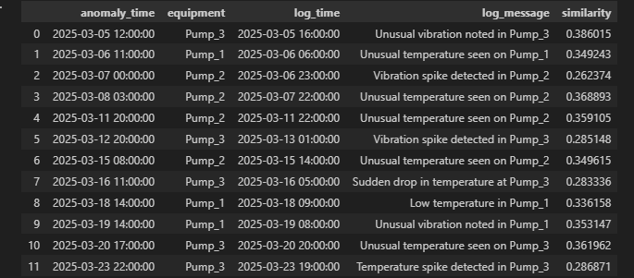
Matching Anomalies to Relevant Text Logs (Based on Meaning & Time)
Each anomaly is linked to a specific equipment like Pump_2. The model filters operator logs for the same equipment and time window. Then it picks the one that semantically matches the sensor readings the best using sentence embeddings and cosine similarity.
This piece tries to find the most semantically matching log for each anomaly. If no good match is found in time, it falls back to the latest log of the same equipment with a low confidence score.

Slide 13
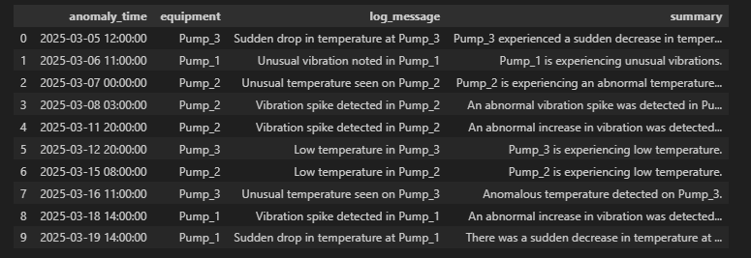
LLM-Based Summarization
Operator log messages that were matched to anomalies are passed to GPT(gpt-3.5-turbo).
The model generates a concise summary of each log message.
This makes the logs easier to interpret for human users.

Slide 14
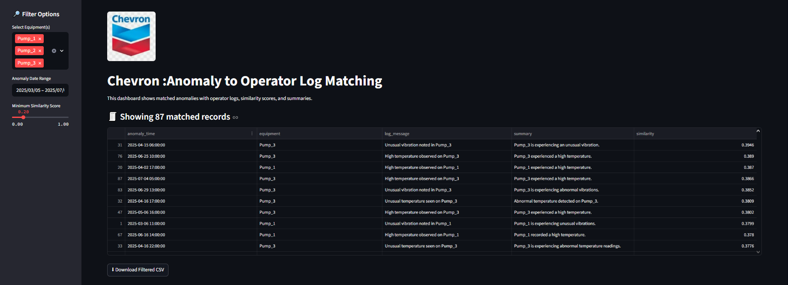
LLM-Based Summarization
After getting the insights , deploying the working prototype using Streamlit.

